Slide 1
Chapter 3a: VLANs
Notes:
Cisco Networking Academy Program
Routing and Switching Essentials v6.0
Chapter 6: VLANs

Slide 2
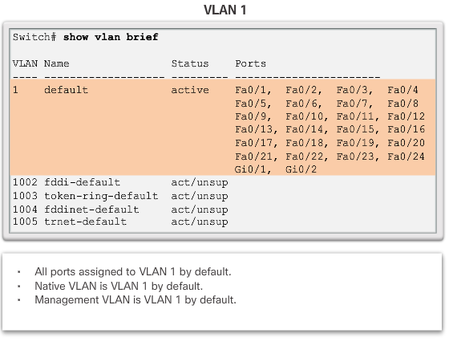
Overview of VLANs
Types of VLANs (cont.)
Notes:
6.1 – VLAN Segmentation
6.1.1 – Overview of VLANs
6.1.1.3 – Types of VLANs (cont.)

Slide 3
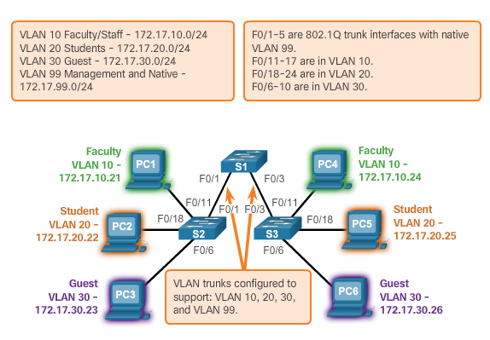
VLANs in a Multi-Switched Environment
VLAN Trunks
The links between switches S1 and S2, and S1 and S3 are configured to transmit traffic coming from VLANs 10, 20, 30, and 99 across the network. This network could not function without VLAN trunks.
Notes:
6.1 – VLAN Segmentation
6.1.2 – VLANs in a Multi-Switched Environment
6.1.2.1 – VLAN Trunks

Slide 4
VLANs in a Multi-Switched Environment
VLAN Trunks (cont.)
A VLAN trunk is a point-to-point link that carries more than one VLAN.
A VLAN trunk is usually established between switches so same-VLAN devices can communicate, even if physically connected to different switches.
A VLAN trunk is not associated to any VLANs; neither is the trunk ports used to establish the trunk link.
Cisco IOS supports IEEE802.1q, a popular VLAN trunk protocol.
Notes:
6.1 – VLAN Segmentation
6.1.2 – VLANs in a Multi-Switched Environment
6.1.2.1 – VLAN Trunks (cont.)

Slide 5
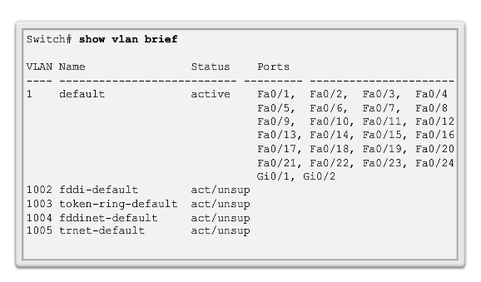
VLAN Assignment
VLAN Ranges on Catalyst Switches (cont.)
Normal Range VLANs
Notes:
6.2 – VLAN Implementations
6.2.1 – VLAN Assignment
6.2.1.1 - VLAN Ranges on Catalyst Switches

Slide 6
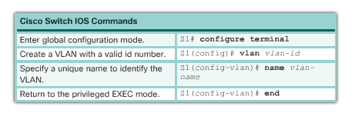
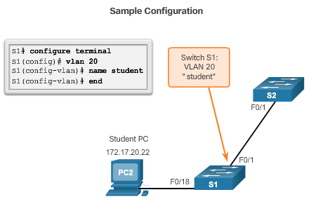
VLAN Assignment
Creating a VLAN
Notes:
6.2 – VLAN Implementations
6.2.1 – VLAN Assignment
6.2.1.2 – Creating a VLAN

Slide 7
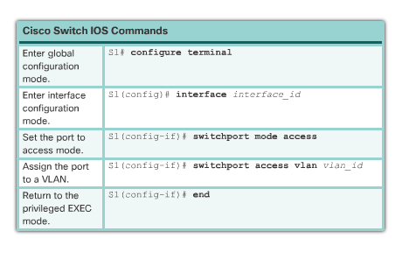
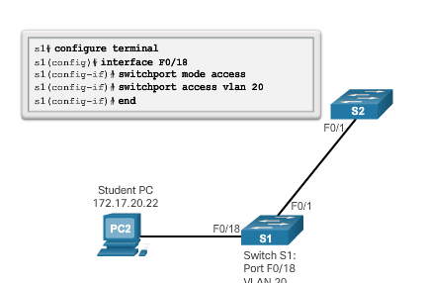
VLAN Assignment
Assigning Ports to VLANs
Notes:
6.2 – VLAN Implementations
6.2.1 – VLAN Assignment
6.2.1.3 – Assigning Ports to VLANs

Slide 8
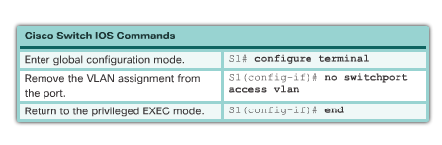
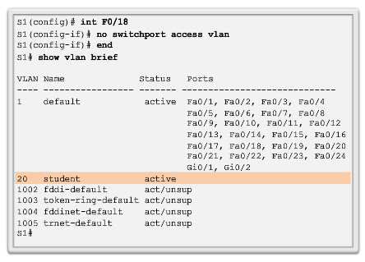
VLAN Assignment
Changing VLAN Port Membership
Remove VLAN Assignment
Interface F0/18 was previously assigned to VLAN 20 which is still active, F0/18 reset to VLAN1
Notes:
6.2 – VLAN Implementations
6.2.1 – VLAN Assignment
6.2.1.4 - Changing VLAN Port Membership

Slide 9
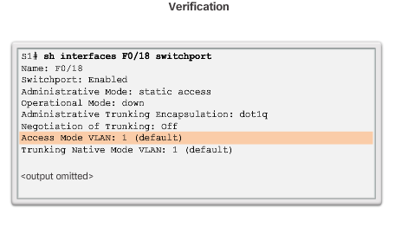
VLAN Assignment
Changing VLAN Port Membership (cont.)
Notes:
6.2 – VLAN Implementations
6.2.1 – VLAN Assignment
6.2.1.4 - Changing VLAN Port Membership (cont.)

Slide 10
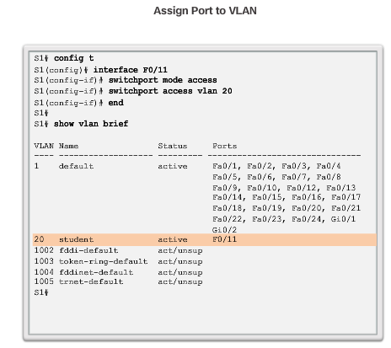
VLAN Assignment
Changing VLAN Port Membership (cont.)
Notes:
6.2 – VLAN Implementations
6.2.1 – VLAN Assignment
6.2.1.4 - Changing VLAN Port Membership (cont.)

Slide 11
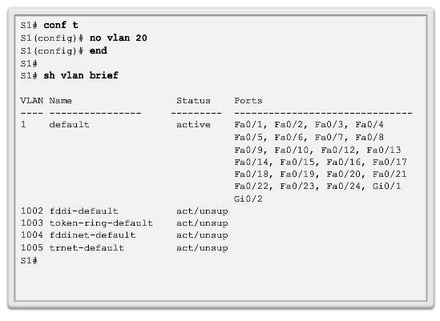
VLAN Assignment
Deleting VLANs
The entire vlan.dat file can be deleted using the delete flash:vlan.dat privileged EXEC mode command
Abbreviated command version (delete vlan.dat) can be used if the vlan.dat file has not been moved from its default location
Notes:
6.2 – VLAN Implementations
6.2.1 – VLAN Assignment
6.2.1.5 – Deleting VLANs

Slide 12
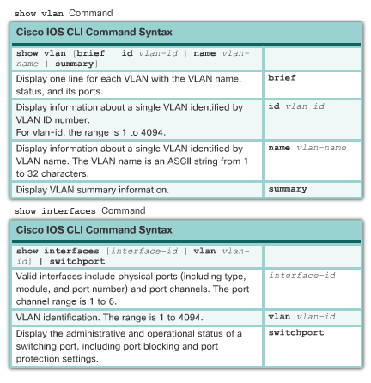
VLAN Assignment
Verifying VLAN Information
Notes:
6.2 – VLAN Implementations
6.2.1 – VLAN Assignment
6.2.1.6 - Verifying VLAN Information

Slide 13
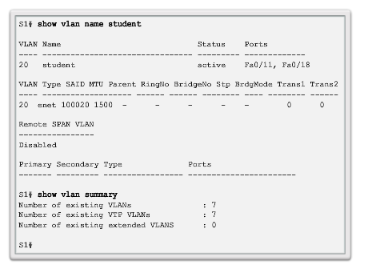
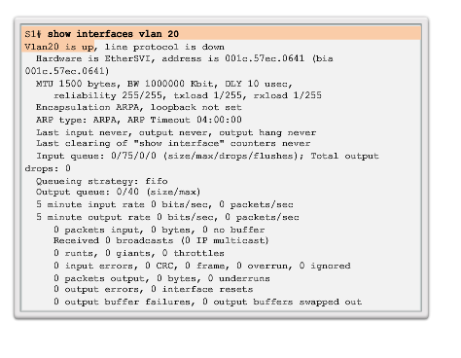
VLAN Assignment
Verifying VLAN Information (cont.)
Notes:
6.2 – VLAN Implementations
6.2.1 – VLAN Assignment
6.2.1.6 - Verifying VLAN Information

Slide 14
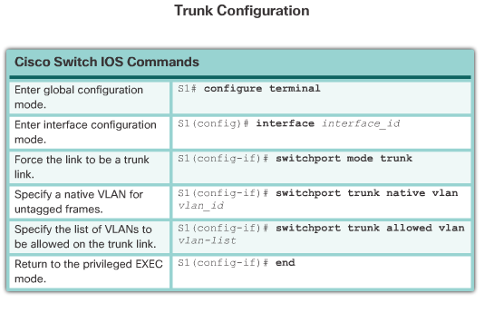
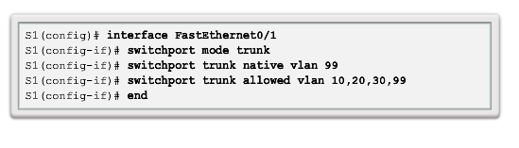
VLAN Trunks
Configuring IEEE 802.1q Trunk Links
Notes:
6.2 – VLAN Implementations
6.2.2 – VLAN Trunks
6.2.2.1 - Configuring IEEE 802.1q Trunk Links

Slide 15
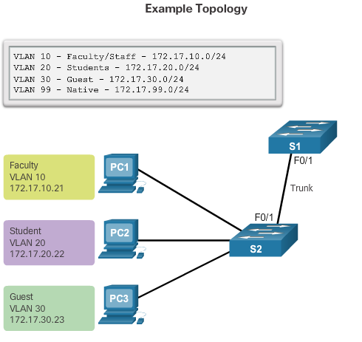
VLAN Assignment
Configuring IEEE 802.1q Trunk Links (cont.)
Notes:
6.2 – VLAN Implementations
6.2.2 – VLAN Trunks
6.2.2.1 - Configuring IEEE 802.1q Trunk Links (cont.)

Slide 16
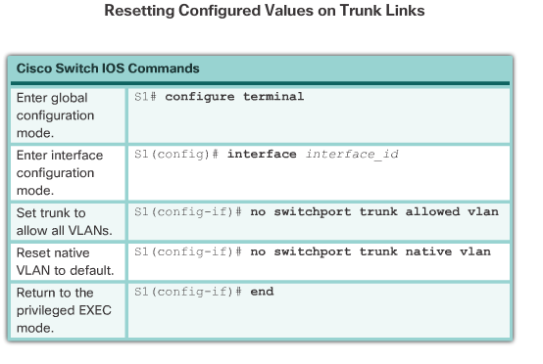
VLAN Trunks
Resetting the Trunk to Default State
Notes:
6.2 – VLAN Implementations
6.2.2 – VLAN Trunks
6.2.2.2 - Resetting the Trunk to Default State

Slide 17
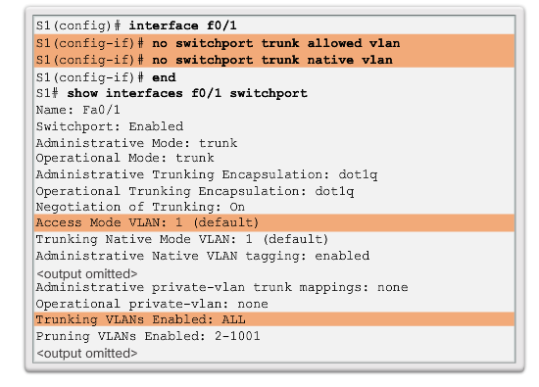
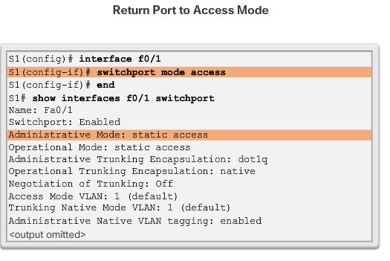
VLAN Trunks
Resetting the Trunk to Default State (cont.)
Notes:
6.2 – VLAN Implementations
6.2.2 – VLAN Trunks
6.2.2.2 - Resetting the Trunk to Default State (cont.)

Slide 18
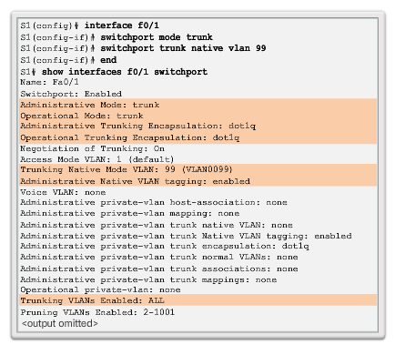
VLAN Trunks
Verifying Trunk Configuration
Notes:
6.2 – VLAN Implementations
6.2.2 – VLAN Trunk
6.2.2.3 - Verifying Trunk Configuration

Slide 19
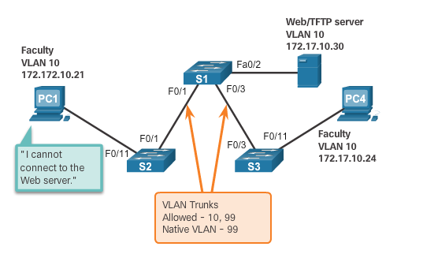
Troubleshoot VLANs and Trunks
IP Addressing Issues with VLANs
It is a common practice to associate a VLAN with an IP network.
Because different IP networks only communicate through a router, all devices within a VLAN must be part of the same IP network to communicate.
The figure displays that PC1 cannot communicate to the server because it has a wrong IP address configured.
Notes:
6.2 – VLAN Implementations
6.2.3 – Troubleshoot VLANs and Trunks
6.2.3.1 - IP Addressing Issues with VLANs

Slide 20
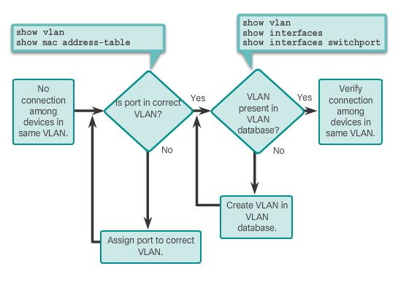
Troubleshoot VLANs and Trunks
Missing VLANs
If all the IP address mismatches have been solved, but the device still cannot connect, check if the VLAN exists in the switch.
Notes:
6.2 – VLAN Implementations
6.2.3 – Troubleshoot VLANs and Trunks
6.2.3.2 - Missing VLANs

Slide 21
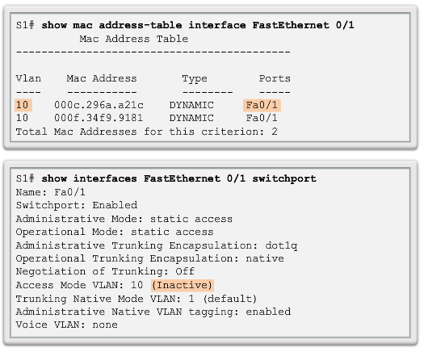
Troubleshoot VLANs and Trunks
Missing VLANs (cont.)
If the VLAN to which a port belongs is deleted, the port becomes inactive. All ports belonging to the VLAN that was deleted are unable to communicate with the rest of the network.
Not functional until the missing VLAN is created using the vlan vlan_id global configuration.
Notes:
6.2 – VLAN Implementations
6.2.3 – Troubleshoot VLANs and Trunks
6.2.3.2 - Missing VLANs (cont.)

Slide 22
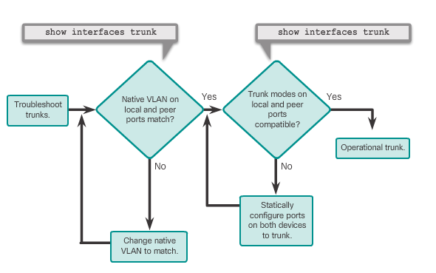
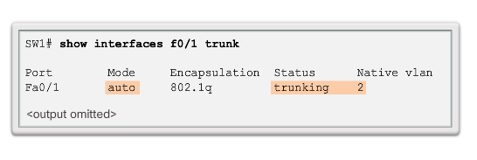
Troubleshoot VLANs and Trunks
Introduction to Troubleshooting Trunks
  Note: To solve a native VLAN mismatch, configure the native VLAN to be the same VLAN on both sides of the link.
Notes:
6.2 – VLAN Implementations
6.2.3 – Troubleshoot VLANs and Trunks
6.2.3.3 - Introduction to Troubleshooting Trunks

Slide 23
Troubleshoot VLANs and Trunks
Common Problems with Trunks
Trunking issues are usually associated with incorrect configurations.
The most common type of trunk configuration errors are:
    Native VLAN mismatches
    Trunk mode mismatches
    Allowed VLANs on trunks
If a trunk problem is detected, the best practice guidelines recommend to troubleshoot in the order shown above.
Notes:
6.2 – VLAN Implementations
6.2.3 – Troubleshoot VLANs and Trunks
6.2.3.4 - Common Problems with Trunks

Slide 24
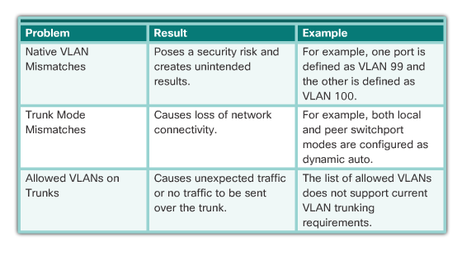
Troubleshoot VLANs and Trunks
Common Problems with Trunks (cont.)
Notes:
6.2 – VLAN Implementations
6.2.3 – Troubleshoot VLANs and Trunks
6.2.3.4 - Common Problems with Trunks

Slide 25
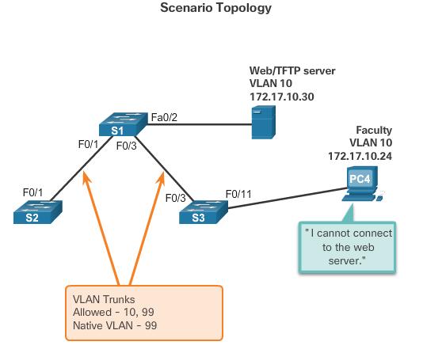
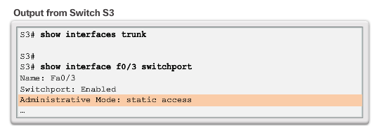
Troubleshoot VLANs and Trunks
Incorrect Port Mode
Notes:
6.2 – VLAN Implementations
6.2.3 – Troubleshoot VLANs and Trunks
6.2.3.5 - Incorrect Port Mode

Slide 26
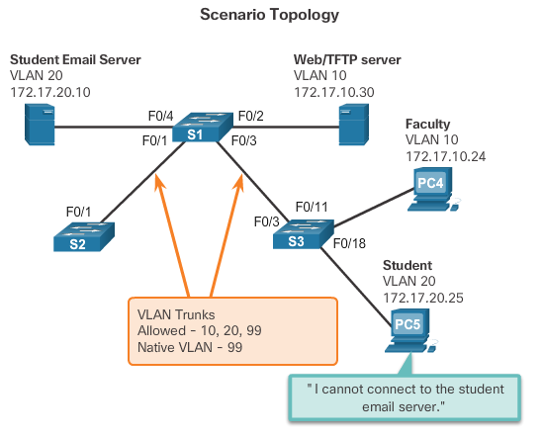
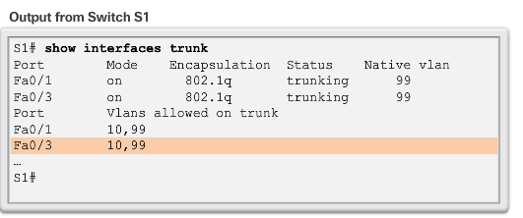
Troubleshoot VLANs and Trunks
Incorrect VLAN List
Notes:
6.2 – VLAN Implementations
6.2.3 – Troubleshoot VLANs and Trunks
6.2.3.6 - Incorrect VLAN List

Slide 27
Troubleshoot VLANs and Trunks
Incorrect VLAN List (cont.)
VLANs must be allowed in the trunk before their frames can be transmitted across the link.
Use the switchport trunk allowed vlan command to specify which VLANs are allowed in a trunk link.
Use the show interfaces trunk command to ensure the correct VLANs are permitted in a trunk.
Notes:
6.2 – VLAN Implementations
6.2.3 – Troubleshoot VLANs and Trunks
6.2.3.6 - Incorrect VLAN List (cont.)

Slide 28
Inter-VLAN Routing Operation
Router-on-a-Stick Inter-VLAN Routing
The router-on-a-stick approach uses only one of the router’s physical interface.
One of the router’s physical interfaces is configured as a 802.1Q trunk port so it can understand VLAN tags.
Logical subinterfaces are created; one subinterface per VLAN.
Each subinterface is configured with an IP address from the VLAN it represents.
VLAN members (hosts) are configured to use the subinterface address as a default gateway.
Notes:
6.3 – Inter-VLAN Routing Using Routers
6.3.1 – Inter-VLAN Routing Operation
6.3.1.3 - Router-on-a-Stick Inter-VLAN Routing

Slide 29
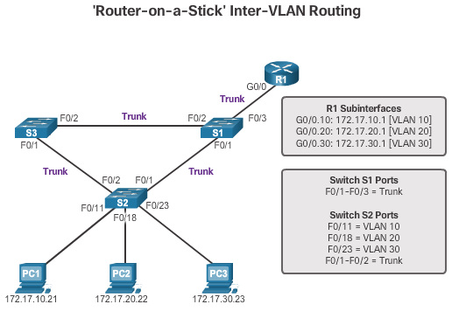
Inter-VLAN Routing Operation
Router-on-a-Stick Inter-VLAN Routing (cont.)
Router interface configured to operate as a trunk link and is connected to a trunked switch port. The router performs inter-VLAN routing by accepting VLAN-tagged traffic on the trunk interface coming from the adjacent switch, and then, internally routing between the VLANs using subinterfaces. The router then forwards the routed traffic, VLAN-tagged for the destination VLAN, out the same physical interface as it used to receive the traffic.
Notes:
6.3 – Inter-VLAN Routing Using Routers
6.3.1 – Inter-VLAN Routing Operation
6.3.1.3 - Router-on-a-Stick Inter-VLAN Routing (cont.)

Slide 30
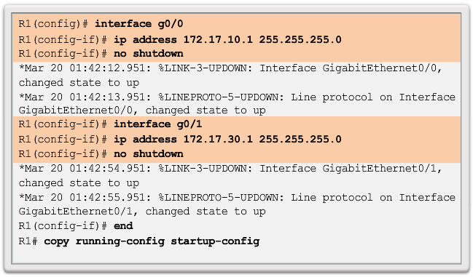
Configure Legacy Inter-VLAN Routing
Configure Legacy Inter-VLAN Routing: Switch Configuration
Notes:
6.3 – Inter-VLAN Routing Using Routers
6.3.2 – Configure Legacy Inter-VLAN Routing
6.3.2.2 - Configure Legacy Inter-VLAN Routing: Switch Configuration

Slide 31
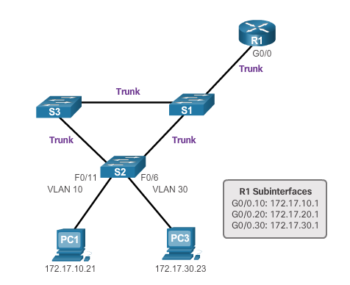
Configure Router-on-a-Stick Inter-VLAN Routing
Configure Router-on-a Stick: Preparation
An alternative to legacy inter-VLAN routing is to use VLAN trunking and subinterfaces.
VLAN trunking allows a single physical router interface to route traffic for multiple VLANs.
The physical interface of the router must be connected to a trunk link on the adjacent switch.
On the router, subinterfaces are created for each unique VLAN.
Each subinterface is assigned an IP address specific to its subnet or VLAN and is also configured to tag frames for that VLAN.
Notes:
6.3 – Inter-VLAN Routing Using Routers
6.3.3 – Configure Router-on-a-Stick Inter-VLAN Routing
6.3.3.1 - Configure Router-on-a Stick: Preparation

Slide 32
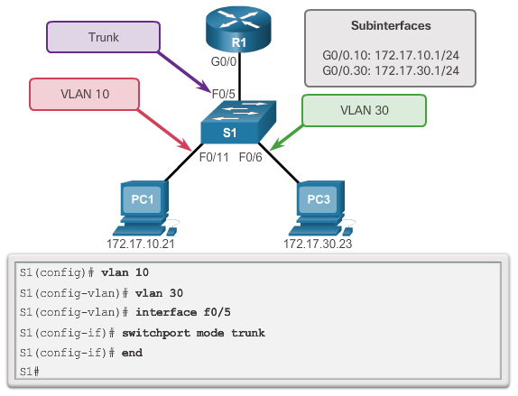
Configure Router-on-a-Stick Inter-VLAN Routing
Configure Router-on-a Stick: Switch Configuration
Notes:
6.3 – Inter-VLAN Routing Using Routers
6.3.3 – Configure Router-on-a-Stick Inter-VLAN Routing
6.3.3.2 - Configure Router-on-a Stick: Switch Configuration

Slide 33
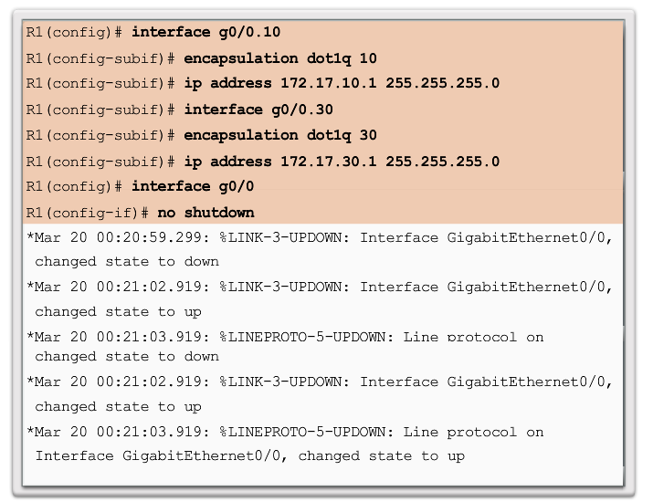
Configure Router-on-a-Stick Inter-VLAN Routing
Configure Router-on-a Stick: Router Subinterface Configuration
Notes:
6.3 – Inter-VLAN Routing Using Routers
6.3.3 – Configure Router-on-a-Stick Inter-VLAN Routing
6.3.3.3 - Configure Router-on-a Stick: Router Subinterface Configuration

Slide 34
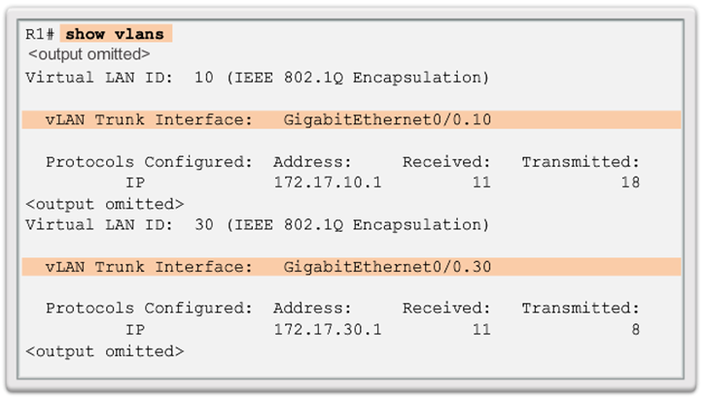
Configure Router-on-a-Stick Inter-VLAN Routing
Configure Router-on-a Stick: Verifying Subinterfaces
Notes:
6.3 – Inter-VLAN Routing Using Routers
6.3.3 – Configure Router-on-a-Stick Inter-VLAN Routing
6.3.3.4 - Configure Router-on-a Stick: Verifying Subinterfaces

Slide 35
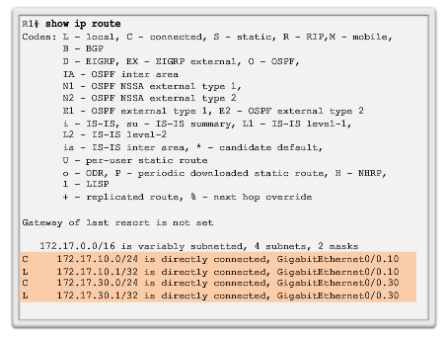
Configure Router-on-a-Stick Inter-VLAN Routing
Configure Router-on-a Stick: Verifying Subinterfaces (cont.)
Notes:
6.3 – Inter-VLAN Routing Using Routers
6.3.2 – Configure Router-on-a-Stick Inter-VLAN Routing
6.3.3.4 - Configure Router-on-a Stick: Verifying Subinterfaces (cont.)

Slide 36
Configure Router-on-a-Stick Inter-VLAN Routing
Configure Router-on-a Stick: Verifying Routing
Access to devices on remote VLANs can be tested using the ping command.
The ping command sends an ICMP echo request to the destination address.
When a host receives an ICMP echo request, it responds with an ICMP echo reply.
Tracert is a useful utility for confirming the routed path taken between two devices.
Notes:
6.3 – Inter-VLAN Routing Using Routers
6.3.3 – Configure Router-on-a-Stick Inter-VLAN Routing
6.3.3.5 - Configure Router-on-a Stick: Verifying Routing

